Slide 1
LLM Project: Building a News Research Tool
Submitted By:- Himanshu Sharma

Slide 2
Introduction
The "LLM Project: Building a News Research Tool" is a hands-on development project that leverages Large Language Models (LLMs) like OpenAI’s GPT, integrated with LangChain, NewsAPI, and Streamlit, to build a smart news summarization tool.
The main goal of this project is to help equity research analysts and users looking for quick, AI-generated news summaries based on real-time queries.

Slide 3
LangChain: Used to design the LLM interaction flow using prompt templates and chains.
OpenAI GPT: Powers the language generation to create concise summaries from news content.
NewsAPI: Fetches the latest and most relevant news articles for a given search query.
Streamlit: Provides a simple web interface where users can input queries and view AI-generated news summaries.

Slide 4
Libraries Used
. Langchain :- Framework for building applications powered by large language models.
OpenAI :-Interface to access OpenAI’s GPT models.
NewsAPI-python:- Python client for NewsAPI
Fetcehs real time news articles based on the user query’s.
Streamlit :- open source python framework for building web apps.

Slide 5
Problem face
API Errors – Issues with invalid or expired OpenAI/NewsAPI keys.
LangChain Setup – Difficulties configuring prompts and chains correctly.
Streamlit UI – Basic interface lacked validation and user feedback.
Summary Quality – AI sometimes gave vague or incomplete summaries.
Deployment – Trouble managing dependencies and securing API keys.

Slide 6
Conclusion
The "LLM Project: Building a News Research Tool" successfully demonstrates the integration of cutting-edge AI tools to create a functional, real-time news summarization application.

Slide 7
Built an end-to-end news research tool using LangChain, OpenAI GPT, NewsAPI, and Streamlit.
Enabled users to input a query, fetch relevant news articles, and generate AI-powered summaries instantly.
Applied prompt engineering and API integration effectively within a Streamlit web app.
Gained practical experience in LLM orchestration, real-time data handling, and web app development.
The project enhances skills relevant to data science, natural language processing (NLP), and AI-powered application development.

Slide 8
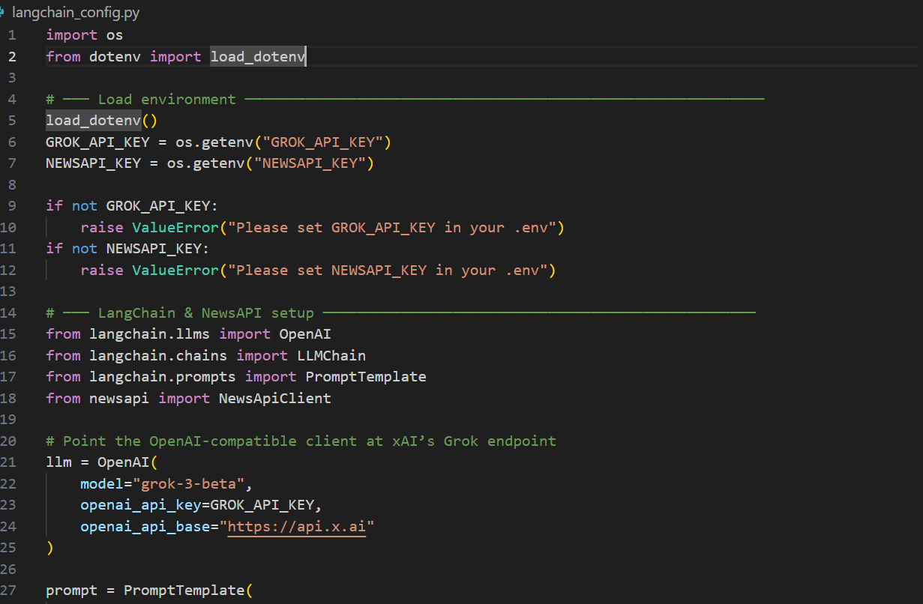

Slide 9
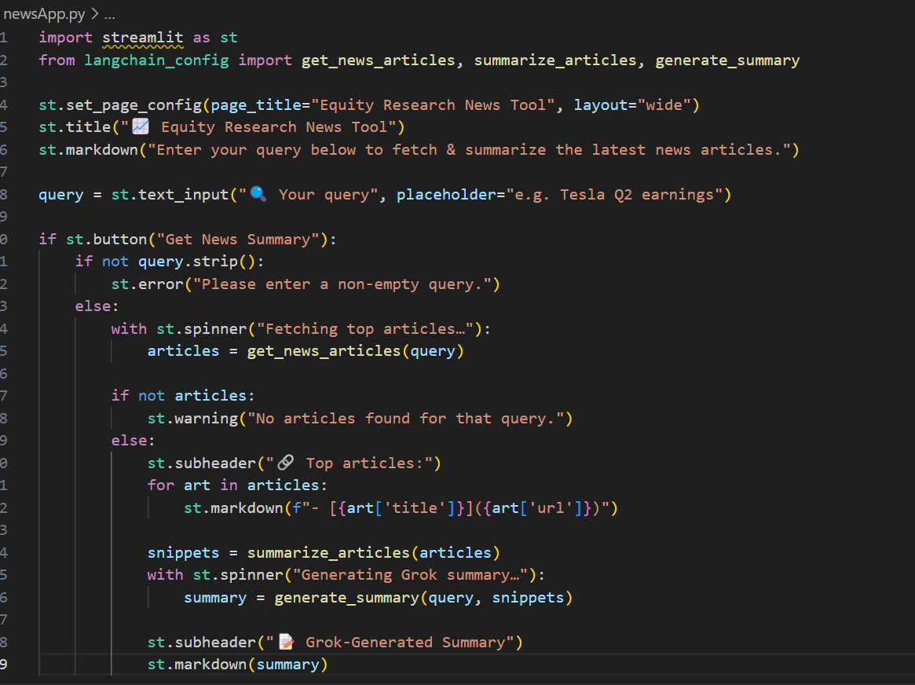

Slide 10
Thank you

